Slide 1
POLICY BASED MANAGEMENT

Slide 2
OVERVIEW
WHAT IS POLICY BASED MANAGEMENT
HOW DID WE MANAGE BEFORE
NEED FOR POLICY BASED MANAGEMENT
CONCEPT BEHIND
TERMINOLOGY
EVALUATION MODES
ASSOCIATED SYSTEM VIEWS
USAGE SCENARIOS & ERROR CODES
DEMO
ADVANTAGES

Slide 3
WHAT IS A POLICY BASED MANAGEMENT
Policy-Based Management is a new feature in SQL Server 2008 that allows administrators to define rules for SQL Servers and enforce them.
The goal of this feature is to make it easier for an administrator to manage one or more servers by preventing servers from being out of compliance with his or her policies.
Policy-Based Management used to manage multiple SQL Server instances from a single location by creating policies that control security, database options, object naming conventions etc.,

Slide 4
HOW WE MANAGED BEFORE??
1.SQL Server Agent
Regularly scheduled jobs
Alerts (asynchronously responding to): errors/severities, performance monitor conditions and WMI events
2.Triggers/Event Notifications
Synchronous and asynchronous event handling mechanisms introduced in SQL Server 2005
3.SQL Server 2005 Surface Area Configuration Tool
Finding/verifying/setting common settings that could impact the attackable “surface area” of your server

Slide 5
Why Use Policy-Based Management?
The only tool that database administrators have had in the past to control the setup of servers and databases is a paper-based policy manual.
Discovering policy violations and who was responsible for them was a manual task. It was often difficult to discover why a policy had been violated, and even more difficult to determine who violated it.
The introduction of Policy-Based Management in SQL Server 2008 solves this problem and can be a significant time saver. It is now possible to define how servers are to be configured and have SQL Server reason over these policies to enforce the rules.

Slide 6
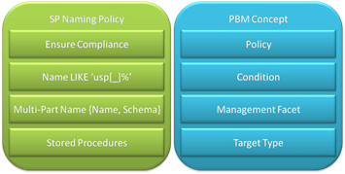
CONCEPT BEHIND
Let's walk through an example: suppose the DBA needs to enforce a naming standard on stored procedures. All stored procedures in the database must start with "usp_" - ("usp" stands for user stored procedure). The picture below maps this policy to the main PBM concepts.

Slide 7
TERMINOLOGY
Policies
A policy is a rule based on a single condition and applied to one or more targets. A policy has an automation mode that describes what SQL Server should do when a policy is violated.
Conditions
A condition contains one or more Boolean expressions that can be combined with AND, OR, and NOT.
Facets
A facet is a collection of properties for an object such as a table, a stored procedure, or an audit. A facet’s properties are used to test various conditions. Facets are pre-defined.
Target :
Target can be entities that are managed by Policy-Based Management, such as an instance of the SQL Server Database Engine, a database, a table, or an index.
Category
You can use categories to manage policies. Categories can be used simply to group related policies, but there are more powerful uses for them as well.

Slide 8
EVALUATION MODES
There are four choices for policy evaluation:
On Change: Prevent
On Change: Log only
On Schedule
On Demand
On Demand : (Non-automated mode and Default) – It can be evaluated by a specific user.
On schedule : (automated mode) – It uses SQL Server agent job to periodically evaluate a policy.
On Change: log only : (automated mode) – It uses event notification to evaluate a policy when a relevant change is made.
On Change: prevent : (automated mode) – It uses DDL triggers to prevent the policy violations.

Slide 9
Policy-Based Management Views
syspolicy_conditions
syspolicy_policies
syspolicy_policy_execution_history
syspolicy_policy_execution_history_details
syspolicy_policy_groups
syspolicy_system_health_state
“Policies are stored in msdb database”.

Slide 10
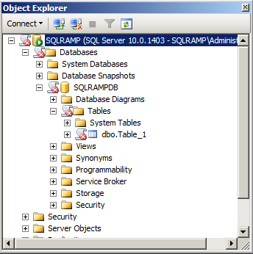
USAGE SCENARIOS
In SQL Server Management Studio,
Object Explorer (OE) shows aggregated
policy violation at every level of a target tree
Enforce naming convention in a database
Apply policies to a group of servers
Tune policies on one server
Export policies from this server

Slide 11
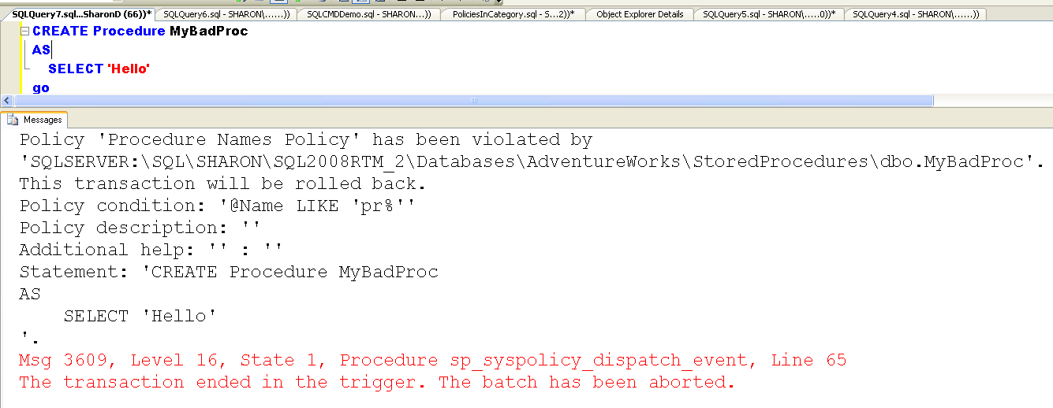
NOTIFICATIONS

Slide 12
ERROR CODES
Message Number | Evaluation Mode
30450 | On change: Prevent when the policy is enabled for automatic evaluation
30451 | On change: Prevent when the policy is set to on demand evaluation
30452 | On schedule
30453 | On change: Log

Slide 13
ADVANTAGES
Management is centralized, thereby reducing the need to configure each server separately.
Administration is simplified, reducing the effort required to maintain standardization and compliance, even in complex environments
Configuration is straightforward and can be done entirely within SQL Server Management Studio
The following Editions supports Policy Based Management
SQL Server 2008 Enterprise
SQL Server 2008 Standard
SQL Server 2008 Workgroup
SQL Server 2008 Web
SQL Server 2008 Express
SQL Server 2008 Express with Tools
SQL Server 2008 Express with Advanced services

Slide 14
DEMO

Slide 15
Thank you

